Slide 1
Bus Number Detection

Slide 2
SETUP GOOGLE CLOUD

Slide 3
Prerequisites
Google account is required
Create cloud project
To create a new project:
Go to the Manage resources page in the Cloud Console.
GO TO THE MANAGE RESOURCES PAGE
On the Select organization drop-down list at the top of the page, select the organization in which you want to create a project. If you are a free trial user, skip this step, as this list does not appear.
Click Create Project.
In the New Project window that appears, enter a project name and select a billing account as applicable. A project name can contain only letters, numbers, single quotes, hyphens, spaces, or exclamation points, and must be between 4 and 30 characters.
Enter the parent organization or folder in the Location box. That resource will be the hierarchical parent of the new project.
When you're finished entering new project details, click Create

Slide 4
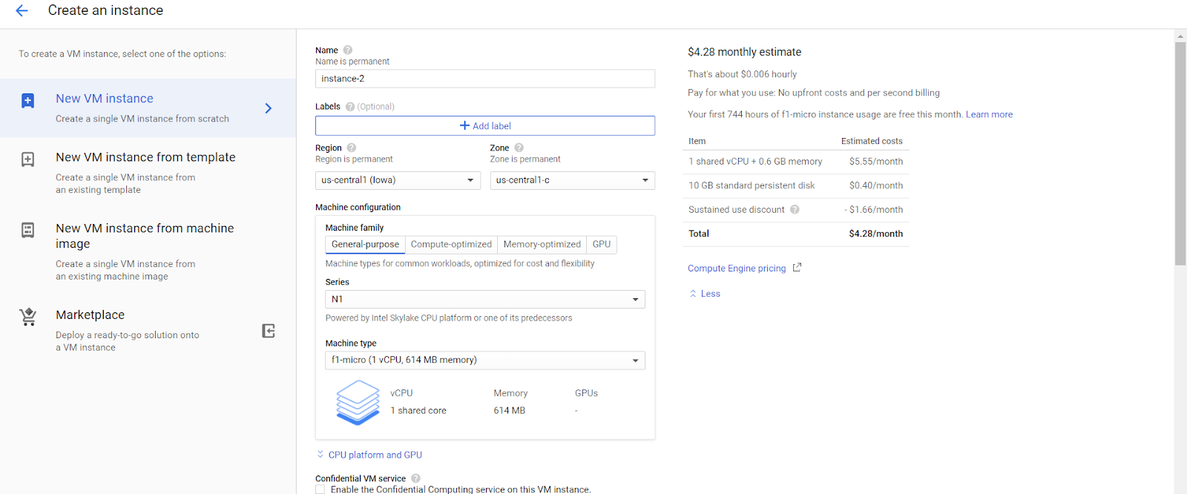
Configuring VM on Google cloud
To create a new project:
Go to the Google Cloud Console. https://console.cloud.google.com/
Then click on Compute Engine > VM instance > Create instance
Then select vm instance configuration as shown below

Slide 5
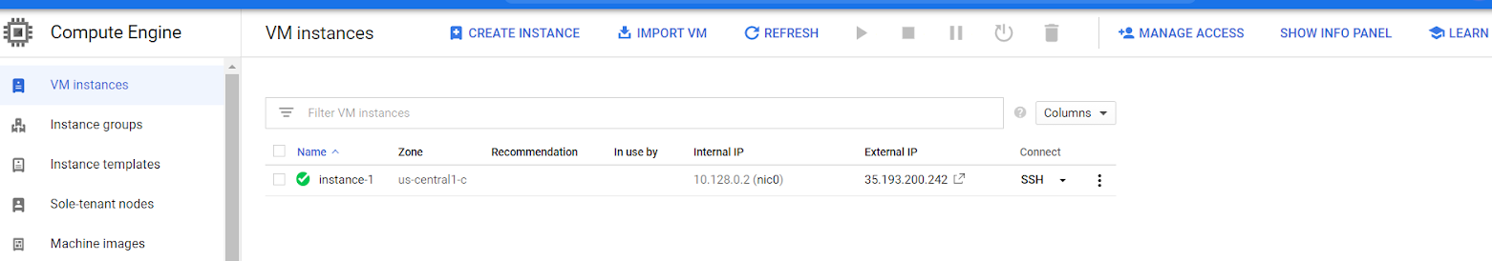

After setting above parameters, left other params default and click on create instance
It will take 3-4 min to create instance
Then click on SSH. It will open ssh connection to instance
Follow the Node red Installation And Boot node red on start Install node on vm
After All steps Done Open VM’s Node red using address <external-ip>:1880. Enxternal ip as shown in image above

Slide 6
Opening Port 8080 with TCP Protocol on Google Cloud
Go to the Google Cloud Console. https://console.cloud.google.com/
Then click on Navigation Menu > VPC network > Firewall
Then select Create Firewall Rule
Fill details as per below screenshot (screenshots from next slide)

Slide 7
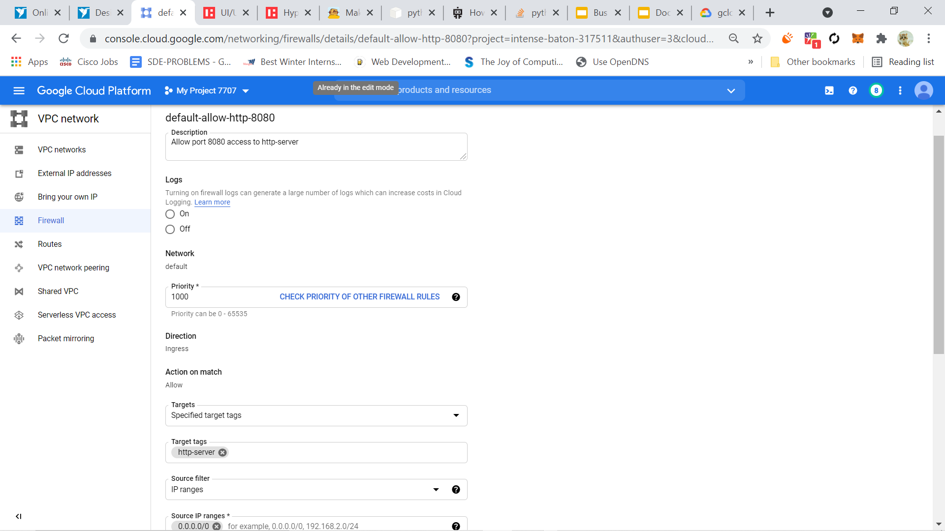

Slide 8
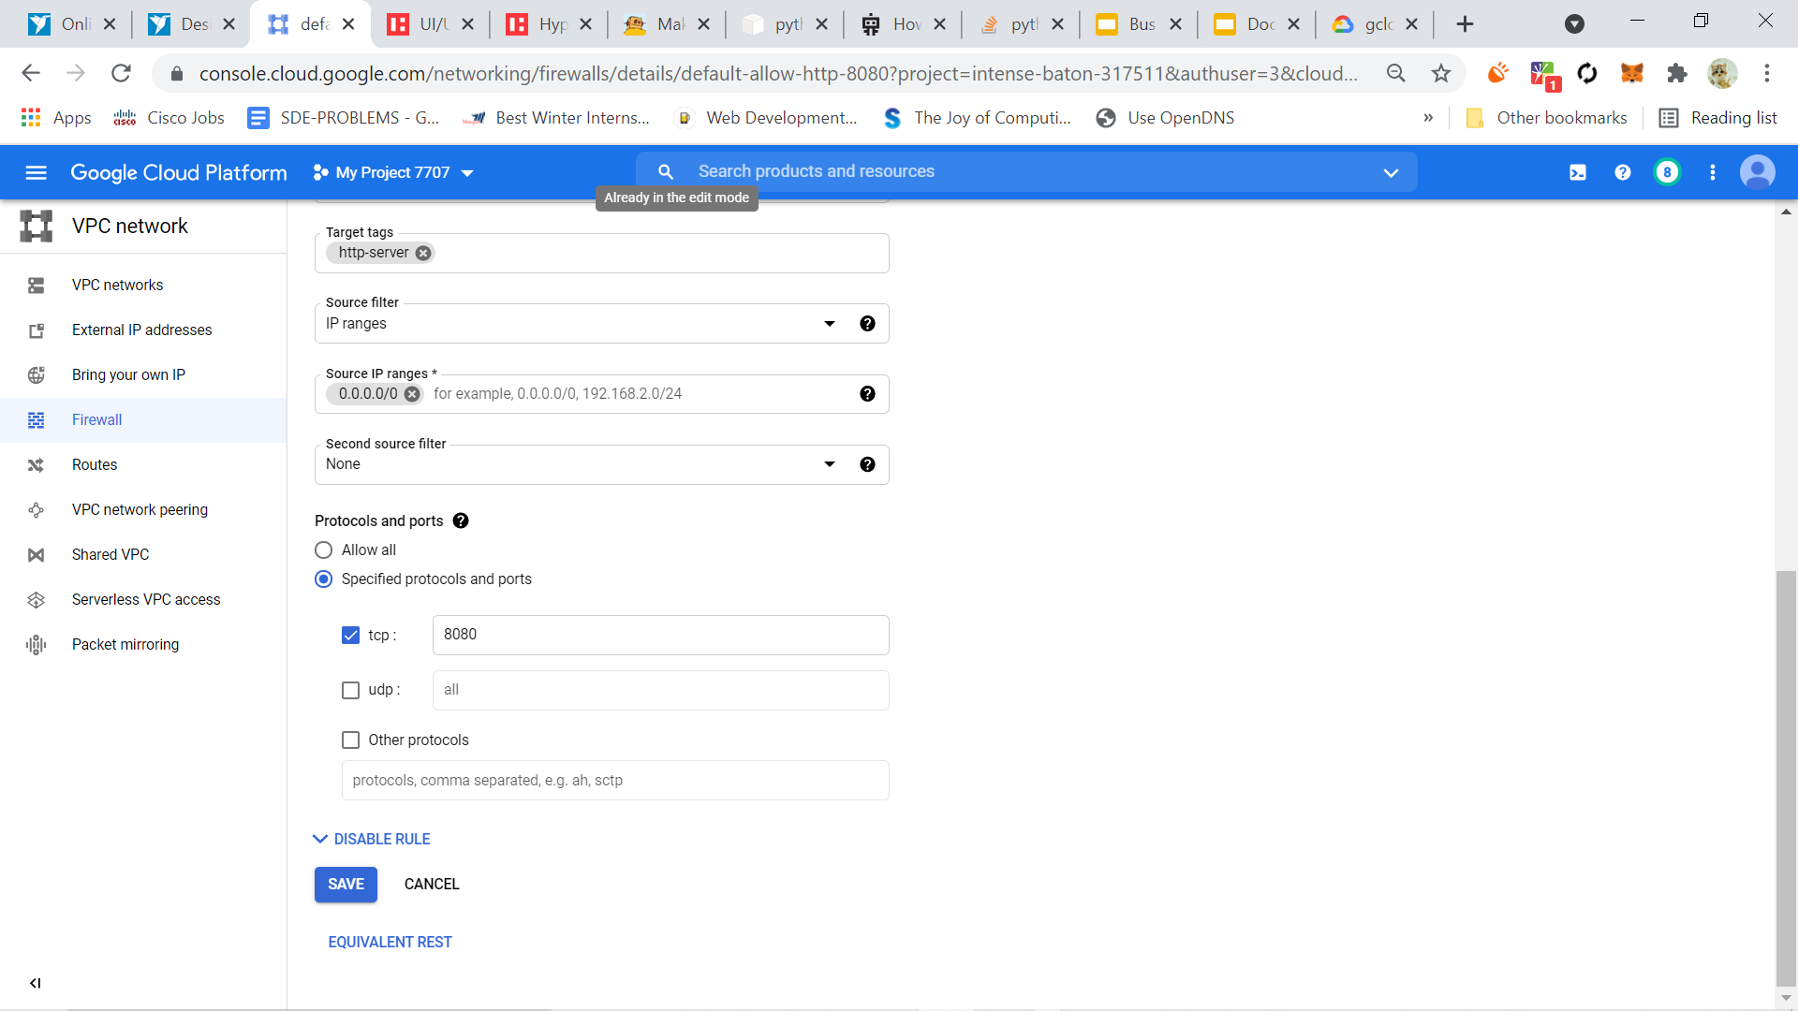

Slide 9
Deploying code on Google Cloud Compute
Go to the Google Cloud Console. https://console.cloud.google.com/
Then click on Compute Engine > VM instance > More actions > Start/Resume
In connect column, select dropdown menu and select Open in browser with SSH.
Upload Server.py to google drive and get its sharable link and set it to Anyone can access.
In the below code, change FILEID with the highlighted part of the link and FILENAME with Server.py and copy it to SSH browser window and execute to download the file.
Example link : https://drive.google.com/file/d/1OXndRIYvyzywcPVkgvLHuPEIP1bLV-t7/view?usp=sharing
Copy this code to the SSH browser window :
wget --load-cookies /tmp/cookies.txt "https://docs.google.com/uc?export=download&confirm=$(wget --quiet --save-cookies /tmp/cookies.txt --keep-session-cookies --no-check-certificate 'https://docs.google.com/uc?export=download&id=FILEID' -O- | sed -rn 's/.*confirm=([0-9A-Za-z_]+).*/\1\n/p')&id=FILEID" -O FILENAME && rm -rf /tmp/cookies.txt
6. Run following command for installation of required libraries :-
python3 -m pip install easyocr flask

Slide 10
Get API access for bus time tracking
https://datamall.lta.gov.sg/content/datamall/en.html
Request API from this link to get the API key to access the live bus time data from singapore server.
Change the API key in the BusNuberAPI.py to connect it to the API and get the data.
This data is used to alert the person about upcoming bus numbers and to verify the bus numbers detected by the camera.

Slide 11
Raspberry Pi Set-up
Connect to raspberry pi.
Open terminal and install python3 and Integrated development environment by running commands :-
sudo apt update
sudo apt install python3 idle3
Install required libraries by running command :-
python3 -m pip install opencv-python easyocr requests httplib2
Code Structure
Server.py - This script of Flask API will be deployed on google cloud compute instance and run on it.
Capture.py - This script starts raspberry pi camera and displays the stream.
Client.py - This script will call the function from capture to fetch a frame and send it to Flask API on cloud for processing it also checks current bus number and alerts on arriving bus by fetching data from BusNumberAPI.
BusNumberAPI.py - This will fetch the time from arrival for buses at current bus station and passes it to the Client code.

Slide 12
Server.py
import easyocr #EasyOCR library is used to detect the text from the image
import re #RegEx library to manipulate the text from the easyOCR to extract the number
from flask import Flask #Flask to create a Flask API to use this as a cloud service
from flask import request #request gets the request varibale when this API is called
from flask import jsonify #jsonify parse the dictionary to a json format to send it back as response
import numpy as np #Numpy to uncompress to arriving data buffer as image frame
import io #io to read the recieved data buffer
app = Flask(__name__) #Declares a Flask APP
reader = easyocr.Reader(['en']) #Declares easy-ocr reader for Eglish

Slide 13
#Function to extract bus number from the frame
def startextracting(img):
bus_no = '' #inintial value of bus number set to empty string
result = reader.readtext(img, detail = 0) #Text result from easyocr reader
for line in result: #Iterates through each line of the result variable
match = re.search(r'[ob\d][ob\d][ob\d]', line.lower()) #searches for three consecutive numbers
if str(type(match)) != '<class \'NoneType\'>': #Checks if the detected type is not None
bus_no = list(match.group()) #converts the detected list of numbers to list to handle general inconsistensies
if bus_no[0]=='0': #If "0" is detected as 1st digit, it is converted to "8" as it is false detection of 8 as 0
bus_no[0]='8'
for i in range(0,3):
if bus_no[i]=='b': #If "b" is detected as 1st to 3rd digit, it is converted to "8" as it is false detection of 8 as 0
bus_no[i]='8'
if bus_no[i]=='o': #If "o" is detected as 1st to 3rd

Slide 14
digit, it is converted to "0" as it is false detection of 8 as 0
bus_no[i]='0'
break
bus_n = str(''.join(bus_no)) #Converts the list of 3 numbers to one string to make a final bus number
return bus_n #Returns the bus number if detected or else empty string is returned in this variable
#Sets the route to url/extractinfo with post method to call the following function as API service
@app.route('/extractinfo', methods=['POST'])
def extractinfo(): #Function to get and process the request to return the output
r = request #request stored in a variable to proesess
print("recieved") #Confirmation of request is recieved
load_bytes = io.BytesIO(r.data) #Reading the bytes and storing it to buffer
img = np.load(load_bytes)['a'] #loading the frame image from the compressed bytes
print("loaded") #Confirmation of decompressing or loading of the image
busno = startextracting(img) #Calling function to extract the busnumber from the image
result = {'busNo': busno} #Making a dictionary to send the response in json format
return jsonify(result) #Returning the dictionary as json

Slide 15
#Main function to start the service on the cloud
if __name__ == "__main__":
#Starts the Flask APP at localhost at port:8080 so that we can port forward the local IP to external IP to get access anywhere in the world
app.run(host='0.0.0.0', port=8080 , debug=True)

Slide 16
Capture.py
import cv2 #Imports Open-CV
from threading import Thread #Imports Tread for running function in the background
frame = 0 #Declares frame variable of frame to check if we get access to the carema in other codes
#Thread to run in background to capture the live feed
class myClassA(Thread):
#Default initialization function of thread
def __init__(self):
Thread.__init__(self)
self.daemon = True
self.start()

Slide 17
#Run function of thread which runs on calling the class
def run(self):
cap = cv2.VideoCapture(1) #Divice is set to capture the video (usb cam in our case)
print(cap) #Prints the interface to check if we got connected to camera
while cap.isOpened(): #Infinite loop to show the read the frames from webcam and show the livefeed
global frame #Calls the global frame variable so frames are written on it
_, frame = cap.read() #Reads the frame from the usb cam
cv2.imshow("frame",frame) #Show the live feed in a window named "frame"
if cv2.waitKey(1) & 0xFF == ord('q'): #Check to exit the loop if we press "q" key on the keyboard
break #Break statment to stop the loop
#Function to get the current frame asynchronously. (to be called to pass the frame for detection)
def get_f():
return frame #Returns the frame
myClassA() #Calls the thread to start the capture from the live feed

Slide 18
Client.py
import requests #Library to post request to Flask API on google cloud
import io #This helps to create a buffer to compress the frame before sending
import numpy as np #Numpy library to save the frame in compressed format before sending
from espeak import espeak #Library to get audio output from raspberryPi
from threading import Thread #Imports Tread for running function in the background
from Capture import get_f #Function to get current frame from the webcan feed call Capture.py to start the webcam feed
from BusNumberAPI import getArrivingBus, getCurrentBus #Functions to get arriving and current bus numbers respectively
url = 'http://104.197.35.208:8080/extractinfo' #URL of API deployed in the google cloud in format 'http://<External_IP>:8080/extractinfo'
busStopNo = int(input("Enter Bus Stop Number: ")) #Takes bus stop number as input from user

Slide 19
#Function to compress the frame before sending to cloud to reduce the latency
def compress(image):
buf = io.BytesIO() #create our buffer
np.savez_compressed(buf, a = image) #compresses the buffer as image
buf.seek(0) #Sets the buffer pointer back to 0 to read the frame when function is called again
return buf #Returns the buffer
#Checks the number given to the current bus number for a given Bus Stop
def checkCurrentNum(num,busStopNo):
l, d = getCurrentBus(busStopNo) #Function to get current bus numbers called from BusNumberAPI.py
if l == None and d == None: #Checks if the return values is none(True means no bus is there)
return None, None, d #Returns None values if there is no bus currently at the Bus Stop
if len(l)>0: #Checks if the number of busses at bus stop is more than 0
boolean = False #Boolean to check if the detected number os true or not
for e in l: #Iterates through list of numbers of the busses at the bus stop

Slide 20
try:
e = int(e) #Tries to convert the bus number to the string (works in case of 807, 901, etc.)
except:
e = int(e[:-1]) #If it fails mmeans it should be anding with character(like 811T) do it removes the "T" and converts to integer
if e == num: #Checks if the number detected is same as the bus present there according to the API
boolean = True #Sets boolean to True if that's the case
break #Breaks the loop
return boolean, l, d #Returns the values of there are buses at the bus stop
return None, None, d #Or else returns None value
#Thread to run in background to speak the correct bus number present there for validation
class BusNoSpeak(Thread):
#Default initialization function of thread but this one takes Bus Stop Number as input
def __init__(self, busStopNo):
Thread.__init__(self)
self.daemon = True
self.busStopNo = busStopNo
self.start()

Slide 21
#Run function of the thread
def run(self):
nume = 0 #Sets initial value of external number variable to 0
de = None #Sets initial value of external dictionary variable to None
while True: #Infinite loop to speak to corrected bus number(from API)
correct, _num, d = checkCurrentNum(123,busStopNo) #Returns current bus number
#Checks if the following operation is done only once for a bus
if (_num != None and nume != _num) or (nume == _num and _num!=None and de != d):
nume = _num #Sets external number list to current ones for checks
de = d #Sets external {num: time} dictionary to current ones for checks
for e in _num: #Itherates through the list
espeak.synth(f"corected bus number {_num}") #Prints current bus number to console
print(f"corrected bus number {e}") #Speaks current bus number to earphones

Slide 22
#Thread to run in background to speak the arriving bus numbers
class BusArriveSpeak(Thread):
#Default initialization function of thread but this one takes Bus Stop Number as input
def __init__(self, busStopNo):
Thread.__init__(self)
self.daemon = True
self.busStopNo = busStopNo
self.start()
#Run function of the thread
def run(self):
le = None #Sets initial value of external list variable to None
de = None #Sets initial value of external dictionary variable to None
while True: #Infinite loop to speak to arriving bus number(from API)
l, d = getArrivingBus(busStopNo) #Returns arriving bus number
#Checks if the following operation is done only once for a bus
if (le == l and de == d) or (l==None and d==None):
continue #Skips the following statments if the

Slide 23
condition satisfies(i.e., operation is repeated)
le = l #Sets external number list to arriving ones for checks
de = d #Sets external {num: time} dictionary to arriving ones for checks
for e in l: #Itherates through the list
espeak.synth(f"bus number {e} is approaching in a few second") #Prints arriving bus number to console
print(f"bus number {e} is arriving soon") #Speaks arriving bus number to earphones
#Main driver function at client side to detect and verify the bus number taking Bus Stop Number as input
def detect(busStopNo):
BusArriveSpeak(busStopNo) #Calls the Bus arrival speaking thread
BusNoSpeak(busStopNo) #Calls the current Bus sopeaking thread
nume = 0 #Sets the external bus number to 0

Slide 24
while True: #Infinite loop to get frames and detect the number
frame = 0 #Declares frame variable of frame to check if we get access to the carema in other codes
while isinstance(frame,int): #Checks if variable type is int we dont have access and continues to check
frame = get_f() #Get the value of global frame variable from Capture.py
#Out of loop when there is a frame captures from the usb cam
buf = compress(frame) #Compresses the frame to send to the Flask API in cloud for processing
r = requests.post(url, data=buf) #Request sent to the Flask API and returns detected number as json format
num = r.json()["busNo"] #The number is extracted frim json by converting it to dictionary and passing the key
try:
num = int(num) #Tries to convert to integer
if num == "": #If its blank then next statments aren't executed and goes to next iteration
continue

Slide 25
except:
continue
if num!=855 or num!=nume: #Checks if the following operation is done only once for a bus
nume = num #Sets external bus number to current ones for the checking purpose
print(f"detected bus number is {num}") #Prints the detected bus number
espeak.synth(f"detected bus number is {num}") #Speaks the detected bus number through the earphones
correct, _num, d = checkCurrentNum(num,busStopNo) #Checks the detected bus number is correct or not
if nume == _num or _num == None: #Checks if the following operation is done only once for a bus
continue
else:
nume = _num #Sets external bus number to current ones for the checking purpose
print(f"Predicted - {num} Orignal - {_num} - {correct}") #Prints the predicted, orignal and correctness of bus number for validation
detect(busStopNo) #Calls the main function to start the detection

Slide 26
BusNumberAPI.py
import json #Imports library to parse the json data and make a dictionary
from urllib.parse import urlparse #Parses the URL
import httplib2 as http #This sends the http request to get the data
import datetime #It is used to manipulate te date time data from the Singapore server to get the remaining time of bus(in seconds)
from pytz import timezone #This is used to set the singapore timezone
pattern = "%Y-%m-%d %H:%M:%S" #Date time pattern for manipulation of data from bus time API
#Authentication parameters
headers = { 'AccountKey' : '5myd8tu8QEedpYd4BB1sAg==', #Acconut key is to be issued from https://datamall.lta.gov.sg/
'accept' : 'application/json'} #this is by default
#This is function call the API to get BusNumber and time left(in seconds).
def getBusDict(busStopNo):
#API parameters
uri = 'http://datamall2.mytransport.sg/' #Resource URL
path = f'ltaodataservice/BusArrivalv2?BusStopCode={busStopNo}' #Path to API
#Build query string & specify type of API call

Slide 27
target = urlparse(uri + path) #Sets target URL
method = 'GET' #Defines GET method
body = ''
h = http.Http() #Get handle to http
response, content = h.request( #Obtain results
target.geturl(),
method,
body,
headers)
jsonObj = json.loads(content) #Parse JSON to get a dictionary
#Declares empty dictionary of busNumbers to store the data
BusNum = {}
keyList = []
#Organizes the data from the server to give us the list
for each in jsonObj["Services"]: #Iterates through the dictionaries of bus and timestamp
time = each["NextBus"]["EstimatedArrival"] #Gets ETA of the next bus
Busnum = each['ServiceNo'] #Gets the bus number of the same
time = time.replace("+08:00","").replace("T"," ") #Manipulates the time string for further manipulation

Slide 28
date = datetime.datetime.strptime(time,pattern) #Converts the datetime string to datetime
now = datetime.datetime.now(timezone('Asia/Singapore')) #Gets currnt siganpore standard time
now = now.replace(tzinfo=None) #Removes timezone info from it for further manipulation
t = date - now #Gets remaining time for the arrival of the bus
key = int(t.total_seconds()) #Extracts the number of seconds from the time variable to use it as a key to the dictionary
BusNum[key] = Busnum #Assign the bus number as value to the corresponding key(or number of seconds to arrival)
keyList.append(key) #Appends the key to the keylist
return BusNum, keyList #Returns both dictionary(of bus number and time left) and keys of the dictionary

Slide 29
#Get current bus number by getting current time from the API
def getCurrentBus(busStopNo):
BusNum, keyList = getBusDict(busStopNo) #Calls the function to get bus number and time remainig
currentBus = [] #List of current bus numbers to be populated
boolean = False #Boolean to check the return values
for e in keyList: #Iterates the list to get current bus numbers
if e==5: #checks if the bus is there or not
currentBus.append(BusNum[e]) #Appends the list if bus is there according to API timings
boolean = True #Sets boolean to True to return the list of current bus number alongwith the latest bus number
if boolean: #Checks the boolean for value to return
return currentBus, BusNum #Returns the current bus numbers
else:
return None, None #Returns None values if there is no bus currently there

Slide 30
#Get arriving bus number by getting current time from the API
def getArrivingBus(busStopNo):
BusNum, keyList = getBusDict(busStopNo) #Calls the function to get bus number and time remainig
arrivingBus = [] #List of arriving bus numbers to be populated
boolean = False #Boolean to check the return values
for e in keyList: #Iterates the list to get arriving bus numbers
if e==20: #checks if the bus is arriving or not
arrivingBus.append(BusNum[e]) #Appends the list if bus is there according to API timings
boolean = True #Sets boolean to True to return the list of current bus number alongwith the latest bus number
if boolean: #Checks the boolean for value to return
return arrivingBus, BusNum #Returns the arriving bus numbers
else:
return None, None #Returns None values if there is no bus arriving soon there

Slide 31
Set up(Laptop)
Download and install latest python and Nvidia CUDA
Open terminal and run commands :-
python3 -m pip install opencv-python easyocr requests httplib2
python3 -m pip install torch==1.9.0+cu111 torchvision==0.10.0+cu111 torchaudio===0.9.0 -f https://download.pytorch.org/whl/torch_stable.html
Navigate to the folder with Laptop codes.
Run python main.py (enter bus stop number when prompted)
Code Structure
Getnum.py - Takes image as input and detects the bus number.
Capture.py - This script starts raspberry pi camera and displays the stream.
Client.py - This script will call the function from capture to fetch a frame and send it to Flask API on cloud for processing it also checks current bus number and alerts on arriving bus by fetching data from BusNumberAPI.
BusNumberAPI.py - This will fetch the time from arrival for buses at current bus station and passes it to the Client code.(code same as RasPi therefore not showing again)
main.py - calls all other functions and show final output in live webcam feed.

Slide 32
GetNum.py
import easyocr #EasyOCR library is used to detect the text from the image
import re #RegEx library to manipulate the text from the easyOCR to extract the number
reader = easyocr.Reader(['en']) #Declares easy-ocr reader for Eglish
#Function to extract bus number from the frame
def startextracting(img):
bus_no = '' #inintial value of bus number set to empty string
result = reader.readtext(img, detail = 0) #Text result from easyocr reader
for line in result: #Iterates through each line of the result variable
match = re.search(r'[ob\d][ob\d][ob\d]', line.lower()) #searches for three consecutive numbers
if str(type(match)) != '<class \'NoneType\'>': #Checks if the detected type is not None
bus_no = list(match.group()) #converts the detected list of numbers to list to handle general inconsistensies

Slide 33
if bus_no[0]=='0': #If "0" is detected as 1st digit, it is converted to "8" as it is false detection of 8 as 0
bus_no[0]='8'
for i in range(0,3):
if bus_no[i]=='b': #If "b" is detected as 1st to 3rd digit, it is converted to "8" as it is false detection of 8 as 0
bus_no[i]='8'
if bus_no[i]=='o': #If "o" is detected as 1st to 3rd digit, it is converted to "0" as it is false detection of 8 as 0
bus_no[i]='0'
break
bus_n = str(''.join(bus_no)) #Converts the list of 3 numbers to one string to make a final bus number
return bus_n #Returns the bus number if detected or else empty string is returned in this variable

Slide 34
Capture.py
import cv2#Imports Open-CV
from threading import Thread#Imports Tread for running function in the background
frame = 0#Declares frame variable of frame to check if we get access to the carema in other codes
#Thread to run in background to capture the live feed
class myClassA(Thread):
#Default initialization function of thread
def __init__(self):
Thread.__init__(self)
self.daemon = True
self.start()

Slide 35
#Run function of thread which runs on calling the class
def run(self):
cap = cv2.VideoCapture(1) #Divice is set to capture the video (usb cam in our case)
print(cap) #Prints the interface to check if we got connected to camera
while cap.isOpened(): #Infinite loop to show the read the frames from webcam and show the livefeed
global frame #Calls the global frame variable so frames are written on it
_, frame = cap.read() #Reads the frame from the usb cam
#Function to get the current frame asynchronously. (to be called to pass the frame for detection)
def get_f():
while isinstance(frame,int): #Checks if variable type is int we dont have access and continues to check
pass
return frame #Returns if we get have access and continues to check

Slide 36
Client.py
from threading import Thread #Imports Tread for running function in the background
from BusNumberAPI import getArrivingBus, getCurrentBus #Functions to get arriving and current bus numbers respectively
from Getnum import startextracting #Function to detect number from the frame
busStopNo = int(input("Enter Bus station number:")) #Takes bus stop number as input from user
#Checks the number given to the current bus number for a given Bus Stop
def checkCurrentNum(num,busStopNo):
l, d = getCurrentBus(busStopNo) #Function to get current bus numbers called from BusNumberAPI.py
if l == None and d == None: #Checks if the return values is none(True means no bus is there)
return None, None, d #Returns None values if there is no bus currently at the Bus Stop

Slide 37
if len(l)>0: #Checks if the number of busses at bus stop is more than 0
boolean = False #Boolean to check if the detected number os true or not
for e in l: #Iterates through list of numbers of the busses at the bus stop
try:
e = int(e) #Tries to convert the bus number to the string (works in case of 807, 901, etc.)
except:
e = int(e[:-1]) #If it fails mmeans it should be anding with character(like 811T) do it removes the "T" and converts to integer
if e == num: #Checks if the number detected is same as the bus present there according to the API
boolean = True #Sets boolean to True if that's the case
break #Breaks the loop
return boolean, l, d #Returns the values of there are buses at the bus stop
return None, None, d #Or else returns None value

Slide 38
#Thread to run in background to speak the correct bus number present there for validation
class BusNoSpeak(Thread):
#Default initialization function of thread but this one takes Bus Stop Number as input
def __init__(self, busStopNo):
Thread.__init__(self)
self.daemon = True
self.busStopNo = busStopNo
self.start()
#Run function of the thread
def run(self):
nume = 0 #Sets initial value of external number variable to 0
de = None #Sets initial value of external dictionary variable to None
while True: #Infinite loop to speak to corrected bus number(from API)
correct, _num, d = checkCurrentNum(123,busStopNo) #Returns current bus number
#Checks if the following operation is done only once for a bus
if (_num != None and nume != _num) or (nume == _num and _num!=None and de != d):
nume = _num #Sets external number list to current ones for checks

Slide 39
de = d #Sets external {num: time} dictionary to current ones for checks
for e in _num: #Itherates through the list
print(f"corrected bus number {e}") #Speaks current bus number to earphones
#Thread to run in background to speak the arriving bus numbers
class BusArriveSpeak(Thread):
#Default initialization function of thread but this one takes Bus Stop Number as input
def __init__(self, busStopNo):
Thread.__init__(self)
self.daemon = True
self.busStopNo = busStopNo
self.start()

Slide 40
#Run function of the thread
def run(self):
le = None #Sets initial value of external list variable to None
de = None #Sets initial value of external dictionary variable to None
while True: #Infinite loop to speak to arriving bus number(from API)
l, d = getArrivingBus(busStopNo) #Returns arriving bus number
#Checks if the following operation is done only once for a bus
if (le == l and de == d) or (l==None and d==None):
continue #Skips the following statments if the condition satisfies(i.e., operation is repeated)
le = l #Sets external number list to arriving ones for checks
de = d #Sets external {num: time} dictionary to arriving ones for checks
for e in l: #Itherates through the list
print(f"bus number {e} is arriving soon") #Speaks arriving bus number to earphones

Slide 41
#Returns number detected from the frame and rpint the check of truth value by comparing to the orignal number
def getNum(frame):
num = startextracting(frame) #Number is detected from the frame
correct, _num, d = checkCurrentNum(num,busStopNo) #Checks the detected bus number is correct or not
print(f"Predicted - {num} Orignal - {_num} - {correct}") #Prints the predicted, orignal and correctness of bus number for validation
return num #Returns the detected number
#Method to get bus stop number in main.py to pass in various functions
def getBno():
return busStopNo #Returns the bus stop number

Slide 42
Main.py
import os #imports os to change the enviornment variable to run multipule threads simultaneously
os.environ["KMP_DUPLICATE_LIB_OK"]="TRUE" #Changing enviornment variable to run multiple threads simultaneously
import cv2 #Open-CV to show the live usb feed and print the number on it when detected
from threading import Thread #Imports Tread for running function in the background
from Client import getNum #Function to get number from the image frame
from Client import getBno #Function to get bus stop number from Client.py
from Capture import get_f #Function to get current frame from te usb cam
from Client import BusNoSpeak #Thread to speak bus number from API
from Client import BusArriveSpeak #Thread to speak alert about arrival of the bus
from Capture import myClassA #Thread to start the usb cam feed
gnum = 0 #Declaring global Number to 0
gboolean = True #Declaring global boolean to True
busStopNum = getBno() #Function to get bus stop number

Slide 43
#Thread to detect the bus number and change the gboolean false when output is arrived
class GetNum(Thread):
#Default initialization function of thread
def __init__(self, busStopNo):
Thread.__init__(self)
self.daemon = True
self.busStopNo = busStopNo
self.start()
#Run function of the thread
def run(self):
global gboolean, gnum #Global variables are called to manipulate
while True: #Infinite while loop to get frame and detect number
framed = get_f() #Gets current frame from usb cam
gnum = getNum(framed) #Dectects number from the frame and stores in gnum
gboolean = False #Set gboolean to False so that function knows that computation is done

Slide 44
#Main function to call all threads and show the live cam feed with overllay if the number is detected
def show():
global gboolean, gnum #Global variables are called to manipulate
myClassA()#Thread to start the usb cam and get frames from it continuously
BusNoSpeak(busStopNum)#Thread to print current bus number from API
BusArriveSpeak(busStopNum)#Thread to print arriving bus number from API
GetNum(busStopNum)#Thread to strat detection of bus number from webcam
while True:#Infininte loop to show the live feed
if gboolean and (gnum=="" or gnum==0): #Checks if any number is not detected(False if there is a number)
frame = get_f() #Gets the frame of the usb cam
cv2.imshow("frame",frame) #Show the live feed in a window named "frame"
if cv2.waitKey(1) & 0xFF == ord('q'): #Check to exit the loop if we press "q" key on the keyboard
break #Break statment to stop the loop
else: #if the number is detected
frame1 = get_f().copy() #make a copy of current frame
#Draws or put the detected number on the current frame
cv2.putText(frame1, gnum, (50,100), cv2.FONT_HERSHEY_SIMPLEX, 3, (0, 255, 0), 2)
gboolean = True #Sets global boolean to True so if condition satisfies till next detection

Slide 45
cv2.imshow("frame",frame1) #Show the live feed in a window named "frame" with overlay of the detected number
if cv2.waitKey(1) & 0xFF == ord('q'): #Check to exit the loop if we press "q" key on the keyboard
break #Break statment to stop the loop
cv2.destroyAllWindows() #Closes the window "frame"
show() #Calls the show function to start the detection from laptopS

Slide 46
Starting the Server script
Go to the Google Cloud Console. https://console.cloud.google.com/
Then click on Compute Engine > VM instance > More actions > Start/Resume
Copy the IP from External IP column to Client.py replacing “<external-ip-google-cloud-compute>”.
In connect column, select dropdown menu and select Open in browser with SSH.
Run following command to start the server side script :-
python3 Server.py
Starting the script on Raspberry Pi (same procedure for laptop)
Go to the folder in which you saved both of the scripts Client.py and Capture.py in terminal:-
cd path/to/that/folder
Run following command to start the script :-
python3 Client.py
To terminate or stop the script just press “Ctrl + C”.

Slide 47
Stopping the google cloud instance
Close the SSH browser window.
Go to the Google Cloud Console. https://console.cloud.google.com/
Then click on Compute Engine > VM instance > More actions > Stop

Slide 48
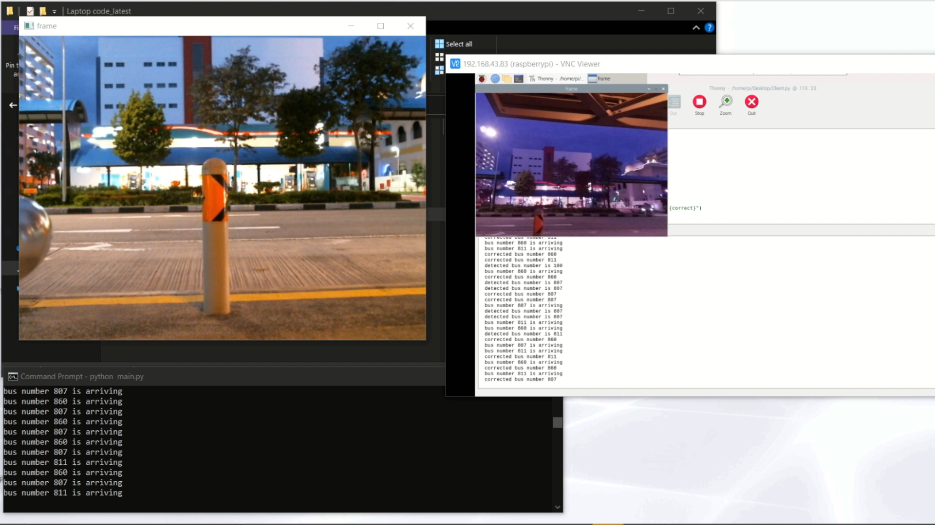
Result and Video Comparison

Slide 49
CONCLUSION
The bus number detection works from both the side i.e front view and side view.
It works better from the side view at day time and works accurately from both the views at night.
We are using Singapore bus station api which is provided by the singapore government.
It collects the footage from camera and upload it on cloud server
Raspberry PI announces the arrival of next bus.
It works better with a local GPU rather than cloud CPU computing.

Slide 50
DRAWBACKS
The camera can’t handle reflection
The process is slow as footage from low pixel camera is uploaded over a cloud which has a relatively low processor due to lower budget
API from the Singapore government is not reliable, as it gives uncertain results sometimes.
Computational limitation on Raspberry Pi.
Laptop having enough computational power are heavy and inconvenient to carry on the go.

Slide 51
FUTURE PLANS
We can integrate with Singapore government and ask them to install high resolution camera at a fixed place to get a better footage which can also work as CCTV.
We can use low-latency Wide Area Network of the government to transfer our data to the server for processing.
We can also use local GPU attached cameras which will easy be affordable with the help of government funding.
We can get a better processing power and GPU at the backend such as powerful cpu and gpu so that we can get accurate and faster detection.
We can also install speakers at every bus stop so that people don’t need to carry device with them everytime.

